Slide 1


Crime, Weather, & Ice Cream in Atlanta, 2016.
Presented By: Team Drop Bear (Carlos Pazos, Doris Akpovwa, Rabia Jamil, & Isaiah Peek)

Slide 2
Research Question & Hypothesis
Did crime occur in high temperatures, close to ice-cream shops, in Atlanta 2016?
Ho: Crime does not correlate with weather and proximity to ice cream shops
Ha: Crime correlates with weather and proximity to ice cream shops

Slide 3

ASSUMPTIONS
1. Only considering crime in Atlanta for 2016 2. Focusing on 5 different types of crimes: - LARCENY-FROM VEHICLE - BURGLARY-RESIDENCE - ROBBERY-PEDESTRIAN - RAPE - HOMICIDE 3. We are using historical weather data including: - AVERAGE TEMPERATURE - HUMIDITY - PRECIPITATION - WIND SPEED - CLOUDINESS 4. We are focusing on ice cream shops using Google API: - Within a Radius of 1 Mile - Business Types: Cafe, Restaurant, Drugstore

Slide 4
DATA
Visual Crossing-Weather API
Google Place API
data.world (Crime in Atlanta 2009-2017-dataset by Bryan Tahb)

Slide 5
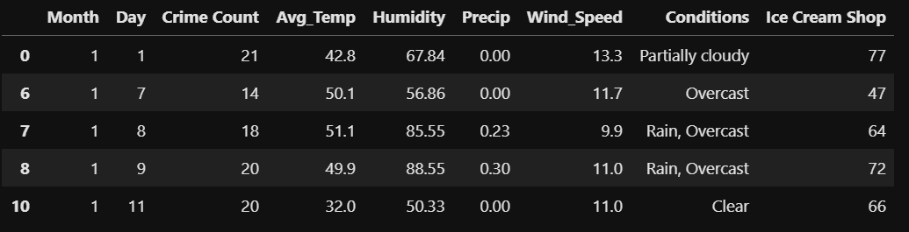
Crime Type-Dataframe

Slide 6
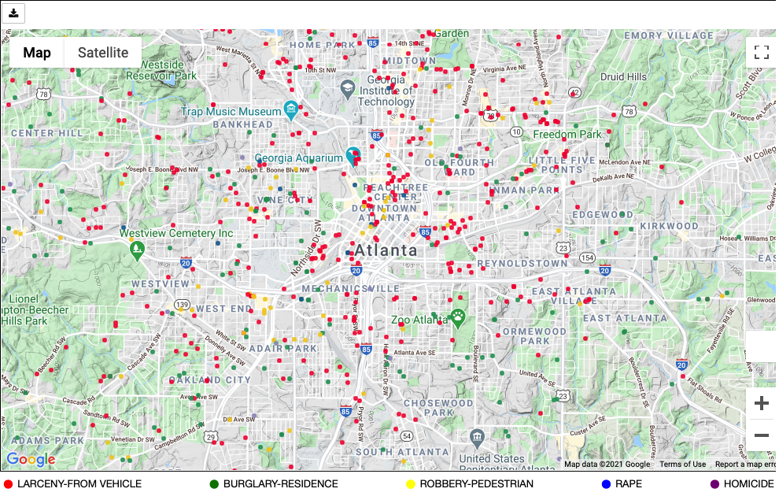

MAP OF ATLANTA & CRIME DISTRIBUTION

Slide 7
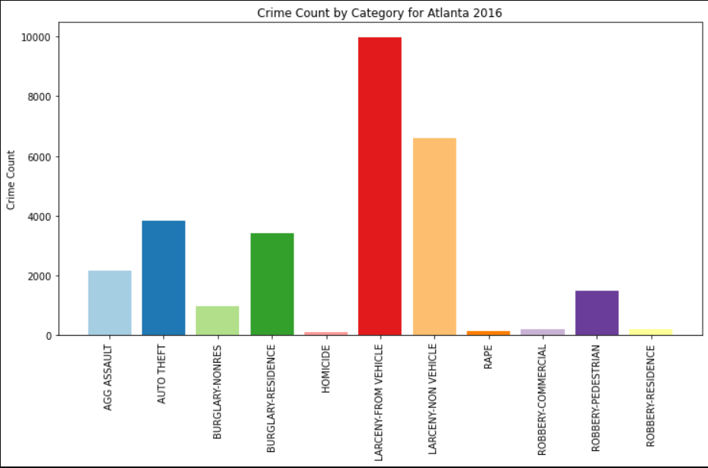

Slide 8
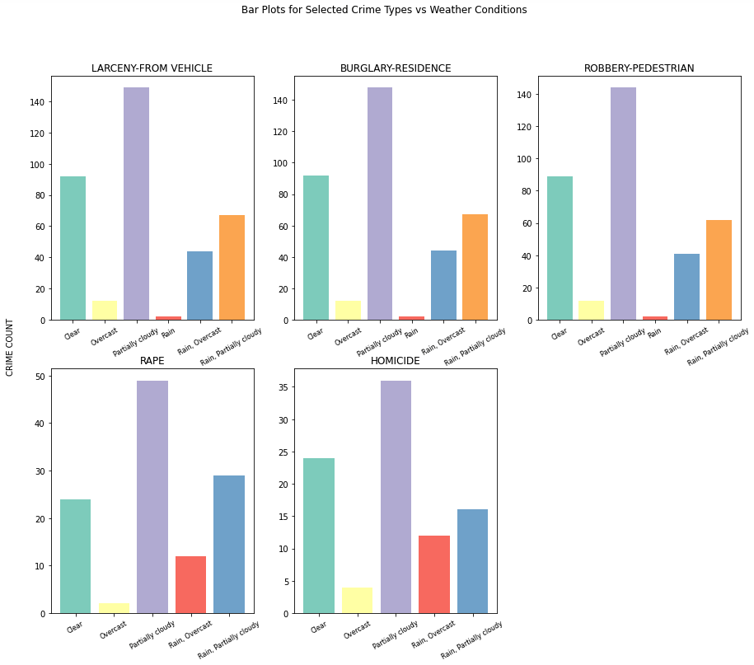

Slide 9
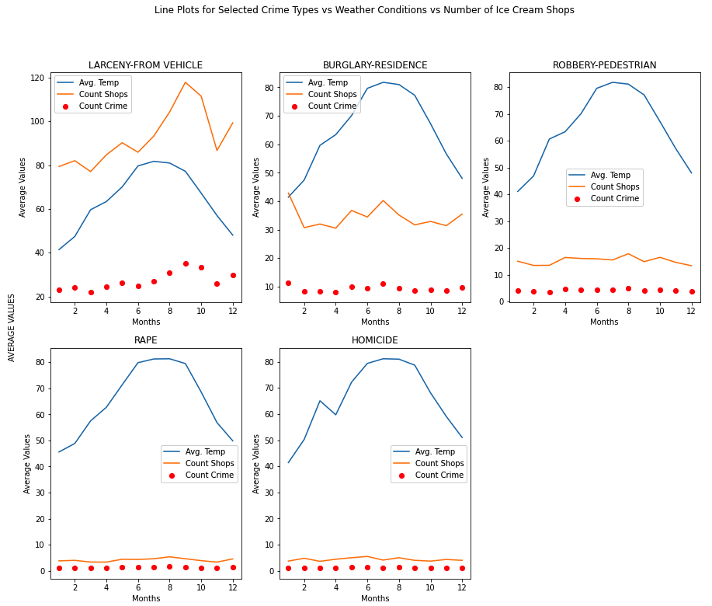

Slide 10
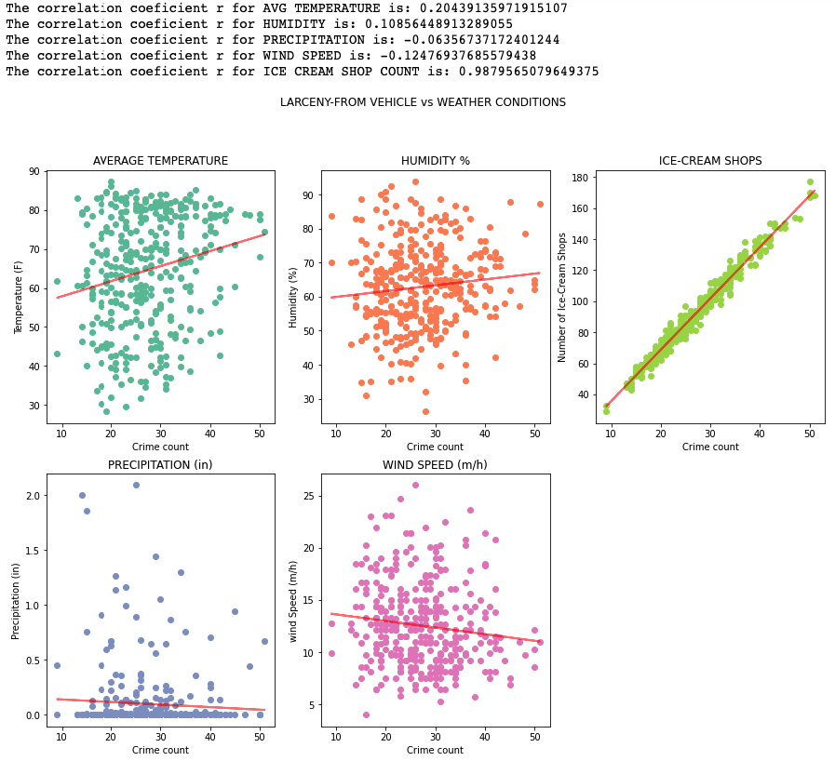

Slide 11
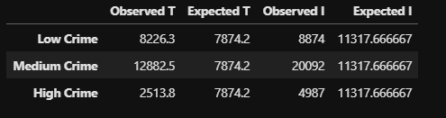
Conclusion
The results state there is correlation between crime and ice cream shops, but there is no correlation between crime and weather, therefore, rejecting the null hypothesis.
ANOVA:
We can reject Ho with p value of 0.0012, most likely Temperature has a level of correlation with amount of crimes
We can reject Ho with p value of 1.73e-116, most likely the number of Ice Cream Shops in the vicinity of a crime has a level of correlation with amount of crimes
Chi-square:
Since the chi-square value of 6850 at a confidence level of 95% exceeds the critical value of 5.99, we conclude that the differences seen in the number of crime counts per crime group are statistically significant for TEMPERATURE.
Since the chi-square value of 10871 at a confidence level of 95% exceeds the critical value of 5.99, we conclude that the differences seen in the number of crime counts per crime group are statistically significant for ICE CREAM SHOP COUNTS.

Slide 12
Future Research
This is limited to the assumptions of the study
We found a correlation of number of ice cream shops and crime, and other variables can be considered:
Other cities
Sales of Ice cream during the same time period
Other weather variables
Observations over multiple years

Slide 13


Care for ice cream??

